Slide 1
DIRECT DEMOCRACY/REPRESENTATIVE DEMOCRACY
(Including a gratuitous dig at Athens)

Slide 2
What does our Constitution have to say about democracy?
Why?

Slide 3
Two Models of Democracy
Direct Democracy
Representative Democracy
The citizens debate and pass the laws, and make the government decisions.
The citizens elect representatives who debate and pass the laws, and make the governing decisions. Those representatives are “accountable” to the citizens.

Slide 4
Direct democracy is more democratic, shouldn’t we have that?
Since the laws impact us, shouldn’t we be the ones who decide whether we want them? We will be paying the taxes, fighting the wars, going to jail for breaking the laws.

Slide 5
Three arguments in favor of representative democracy
Numbers
Time
Expertise

Slide 6
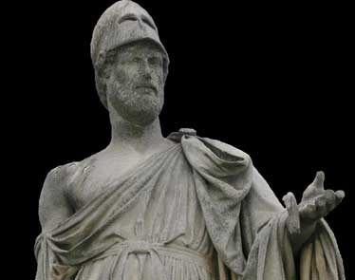
An Example: Athenian Democracy
Emerged in 5th Century BC
Most Greek city-states were ruled by “aristocratic council”
In order to get support, (because of war and inequality) concessions were needed to farmers/artisans

Slide 7
What made democracy possible?
Growing literacy
Small size (this was a city-state). Athens had between 30,000-45,000 citizens.
The idea of “civic virtue”: participation was a responsibility, not a right.
Slavery

Slide 8
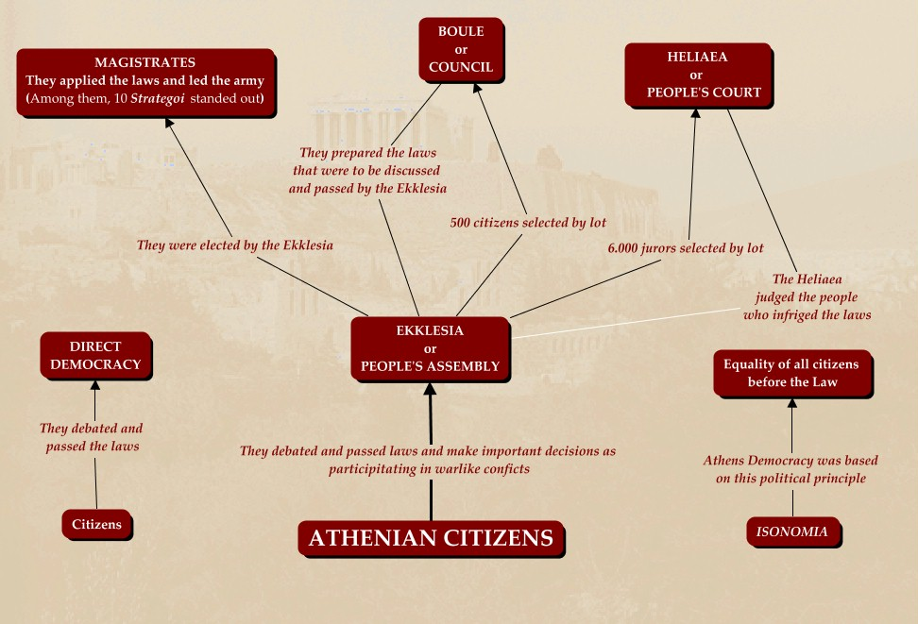

Slide 9
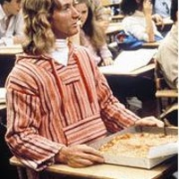
“Hey, Mr. Lucas, what’s your problem? Athenian democracy doesn’t sound so bad”

Slide 10
Problems with Athenian democracy
Numbers: Restrictions on who could participate kept the numbers artificially low.

Slide 11
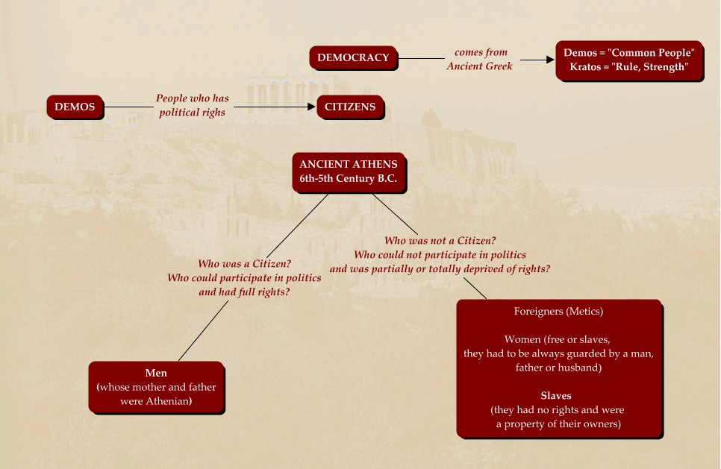

Slide 12
Problem #2: Time
The assembly would meet for one whole day, for once a week. Furthermore, since this was before cars, in an agricultural society it would often take a day to get to assembly, and another day to get back home to the farm. That’s a total of three days a week. How did they manage this?

Slide 13
Problem #3: Expertise
Did everyone have an equal chance to speak in the assembly? If only some were able to speak, who got chosen to speak?

Slide 14


